Slide 1
Human-Powered Vehicle Team
Preliminary Design Presentation
By: Yen C., Yujie Z., Abdulh A., Daniel Q., Connor T.

Slide 2
Project Description
What is a Human Powered Vehicle?
A light-frame vehicle, typically bicycles
Optimize human performance by isolating muscle groups that generate the most power and cause the least amount of fatigue
Aim to be both powerful and speedy
Our Team
Create a Human Powered Vehicle design that is efficient and departs from the standard bicycle propulsion model.
Design a compelling propulsion system and incorporate the design into the other HPV capstone team’s project.
Outperform bicycle HPV’s
Be capable of storing excess energy
Yen
Notes:
HPV’s are vehicles that strive to optimize human performance to generate the most speed and power in a light weight vehicle (that mostly tend to be bicycles) by isolating muscle groups that deliver the most power and cause the least amount of fatigue.
The goal of this team is to design a compelling propulsion system for our Human Powered Vehicle. This project is in collaboration with another capstone team who will incorporate our design.

Slide 3
Background & Current S.o.t.A.
According to the Engineering Requirements and the information we have found, we must combine some key parts to draw a sketch. (Key part: Posture, Energy storage, Propulsion)
Problem to Solve
Improve efficiency
Make driver comfortable
Reduce the weight
Make it safe
Yujie

Slide 4
Customer Requirements
Customer Requirements
1 - Maximum power attain from human
2 - Achieve maximum stable speed
3 - High power delivered by vehicle
4 - Utilize maximum muscles of human
5 - Reduce power losses
6 - Reduce friction
7 - Safe to drive
8 - Light weight
9 - High mechanical efficiency
10 - Low aerodynamic drag
Abdulh

Slide 5
Engineering Requirements
Engineering Requirements Target
1 - Efficiency : 25%
2 - Human power : 0.5 hp
3- Time to achieve max speed : 40 s
4 - Number of muscle groups to use : 4-6
Abdulh

Slide 6
Concept Generation & Skills Acquired
Concepts generated by each individual come together to make the best design possible. To build these concepts, we needed to focus on controlling factors based on our individual learning.
Research from Abdulh and Yen can collectively be used to read force outputs from the propulsion system
Research from Connor can be used to track outputs from the power source (humans)
Research from Daniel can be used to effectively retain all of this energy
In summation, the goal is ultimately, to see which motions are most efficient for human output, as Connor has studied, and how to safely employ them. Once this is accomplished, and the energy has been stored, and released, we need to measure our final output.
The next slide will show what initial concepts were considered
Daniel

Slide 7
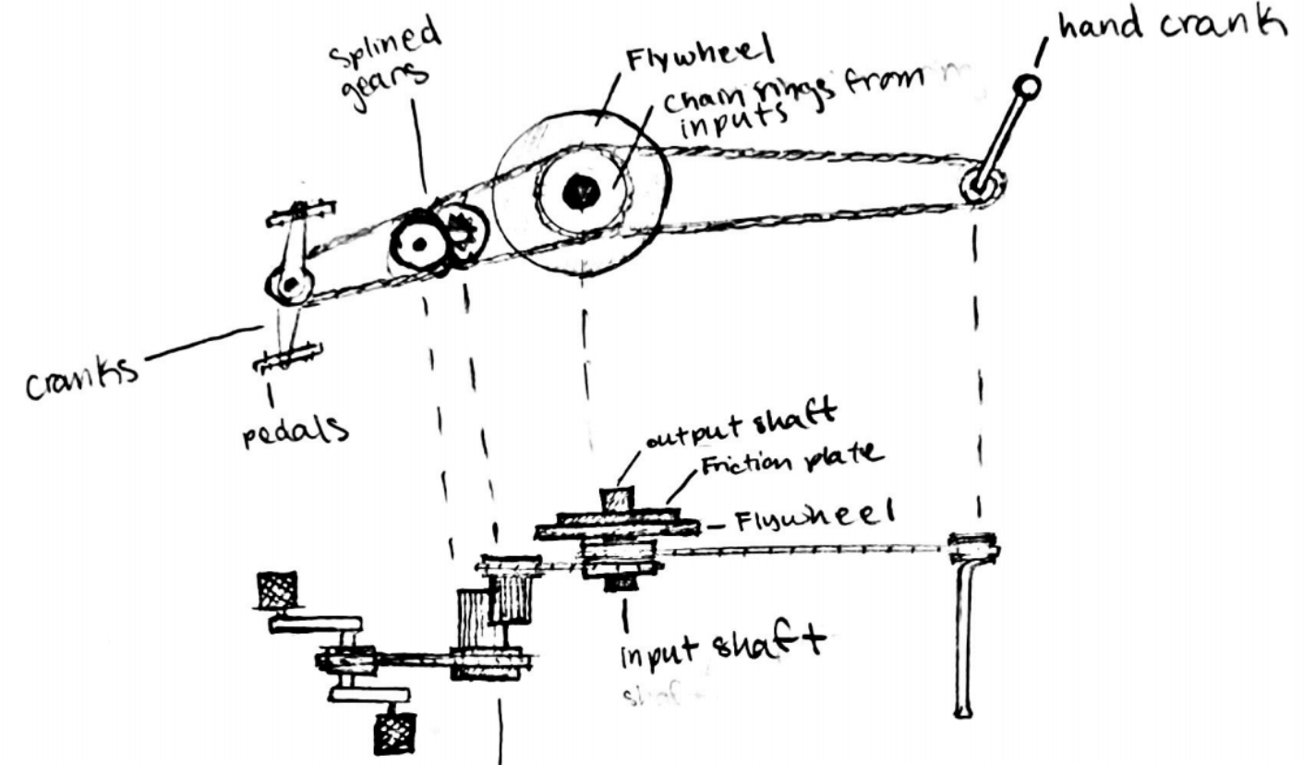
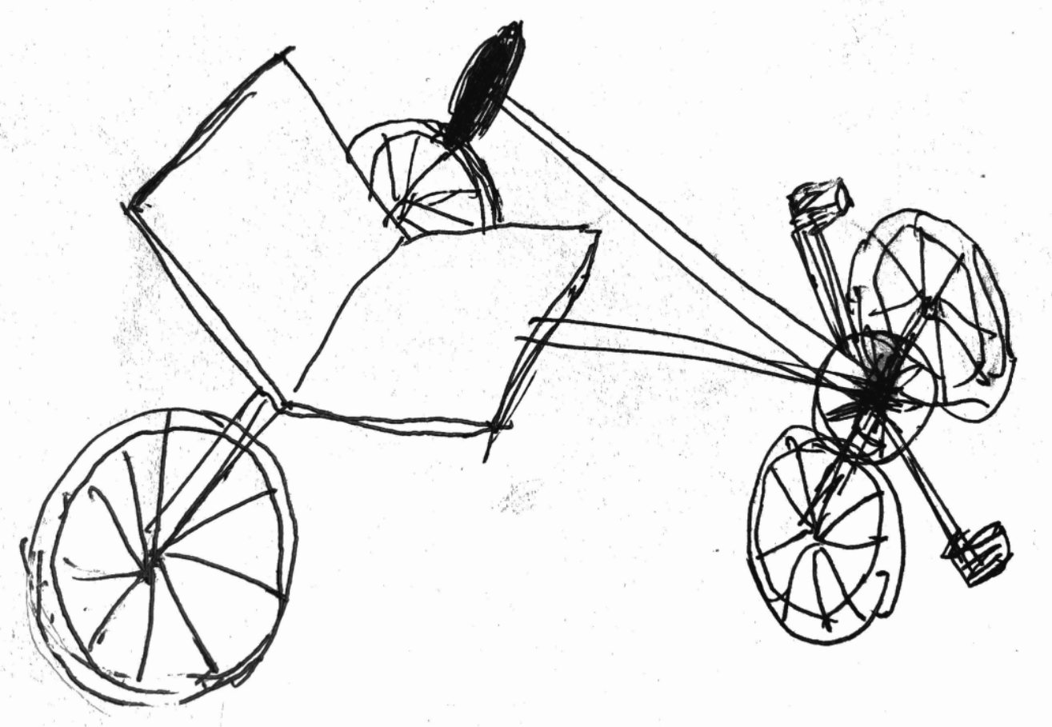
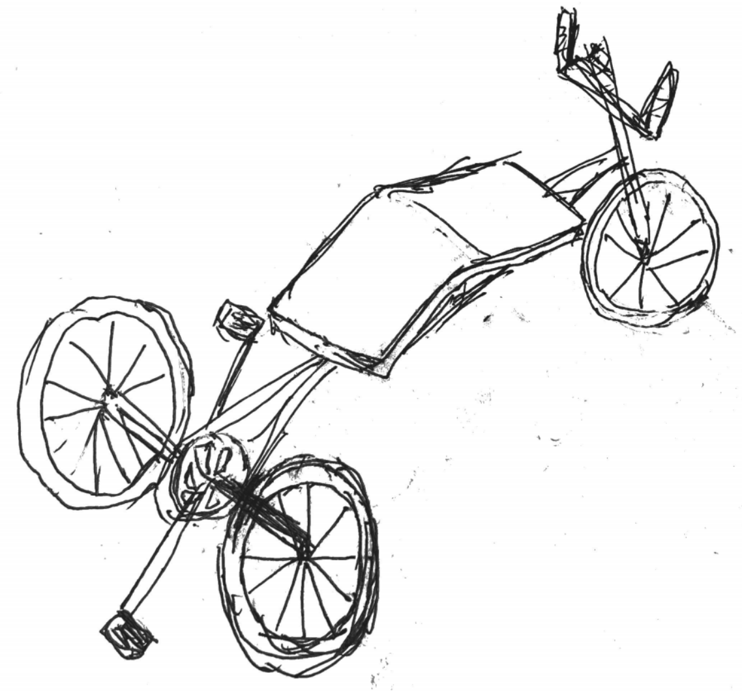
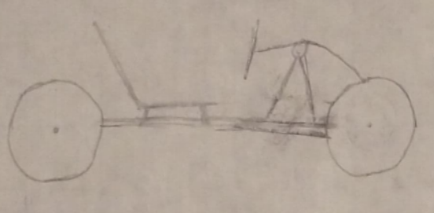
Concept Evaluation
Preferred Design Features:
Stored Energy - Flywheel vs Hydraulics
Propulsion Style - Row & Pedal Combo
Each Meet Engineering Requirements
Alternatives:
Rowing or Pedaling alone
Row “crank” vs Row “cord pull”
Flywheel vs Direct Power to Axle
Pedal Sitting or Pedal Prostrated
We have not considered prototyping yet. If we do, a proof-of-concept would be an ideal way to start. It would probably be between 1:2 and 1:8 scale of the full-scale prototype.
1.
3.
2.
4.
Connor

